Slide 1
DECISION Control and Looping Statements

Slide 2
Introduction
What is branching in c?
Branching gets its name from the fact that the computer can select which branch to follow.
Programs written in the C language execute statements one after the other.
Instructions usually need to be altered in order.
A series of instructions can be rearranged in the C programming language using statements. These sentences are referred to as control statements.
Moving swiftly between different program portions is made easier by these statements. Control might be transferred unconditionally or under specific restrictions

Slide 3
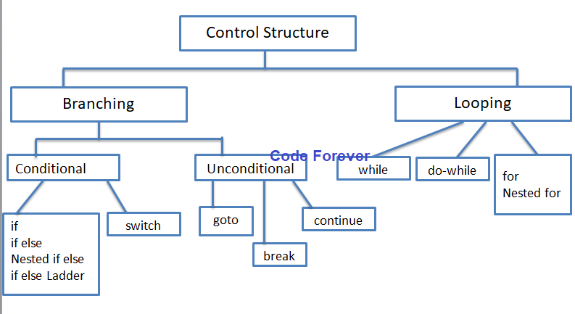
Introduction
Image Courtesy : Code Forever site

Slide 4
Conditional Branching Statements
It contains the statements that validate the validity of an expression before running the code.
A statement from a collection of statements may be processed only by the decision and case-control statements. These also go by the name of conditional statements.
The various types of conditional statements are
if
if else
nested if
switch
else if ladder

Slide 5
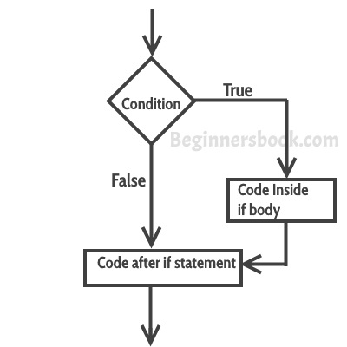
if Statement
.
Use the if statement to specify a block of code to be executed if a condition is true.
Syntax
if (condition) {
// block of code to be executed if the condition is true
}
Note that if is in lowercase letters. Uppercase letters (If or IF) will generate an error.

Slide 6
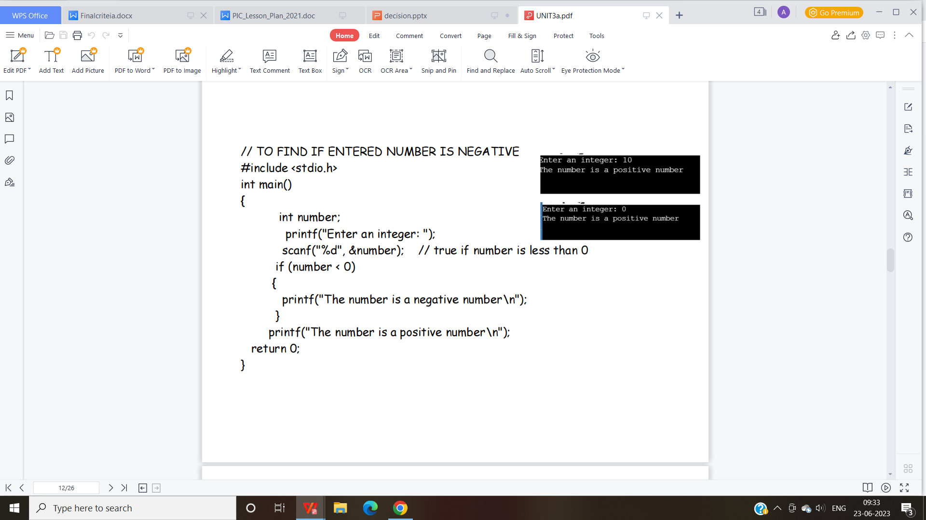
If statement Example

Slide 7
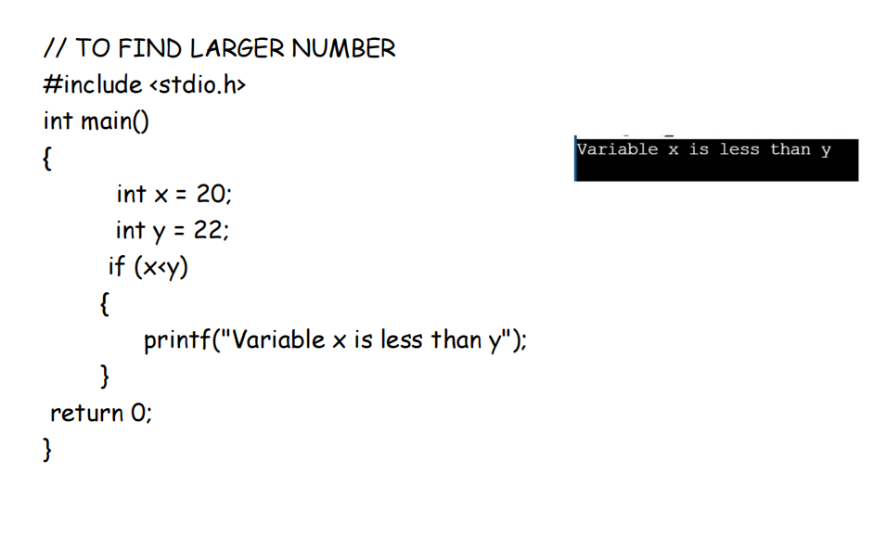
If statement Example
Example -2

Slide 8
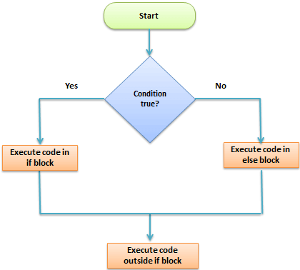
If –else statement
A single condition with two distinct blocks also appears in this sentence. There are two types of blocks: true and false.
Syntax
The syntax for the if-else statement is given as below:
if (condition)
{
Block of statements;
}
else
{
Block of statements;
}

Slide 9
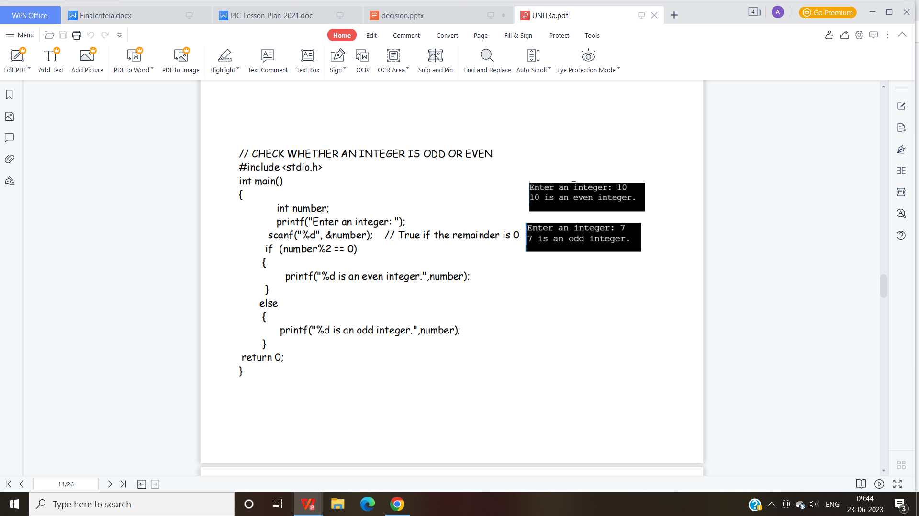
If else statement example

Slide 10
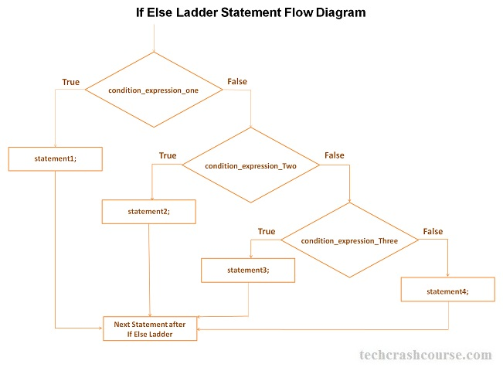
if else if (if else ladder)
The if else ladder statement in C programming language is used to test set of conditions in sequence.
An if condition is tested only when all previous if conditions in if-else ladder is false.
If any of the conditional expression evaluates to true, then it will execute the corresponding code block and exits whole if-else ladder.

Slide 11
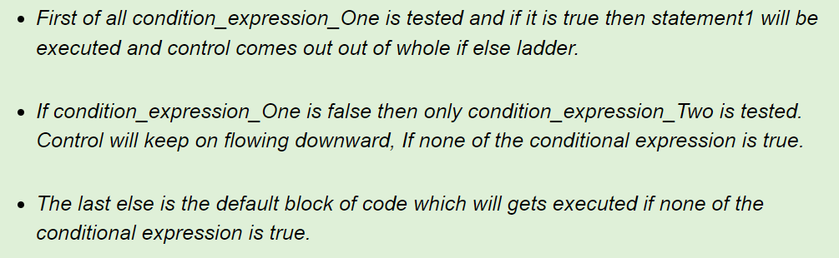
Syntax – if else ladder
if(condition_expression_One) { statement1; } else if (condition_expression_Two) { statement2; } else if (condition_expression_Three) { statement3; } else { statement4; }

Slide 12
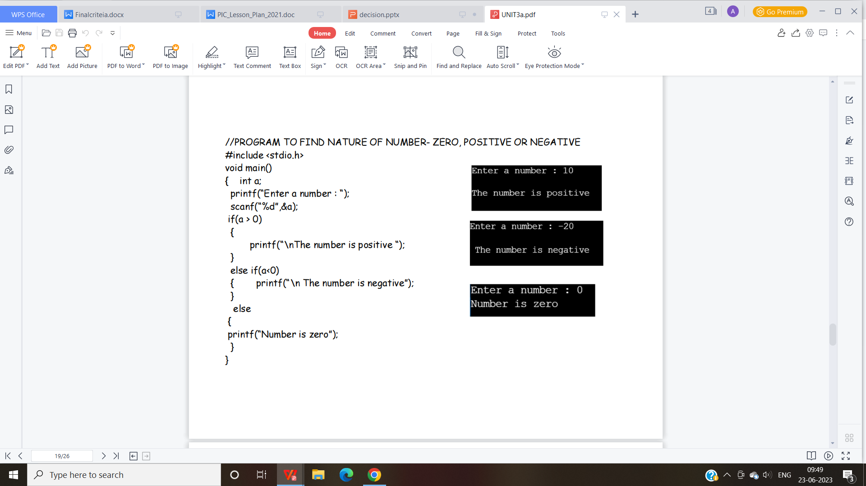
Example if else ladder
.

Slide 13
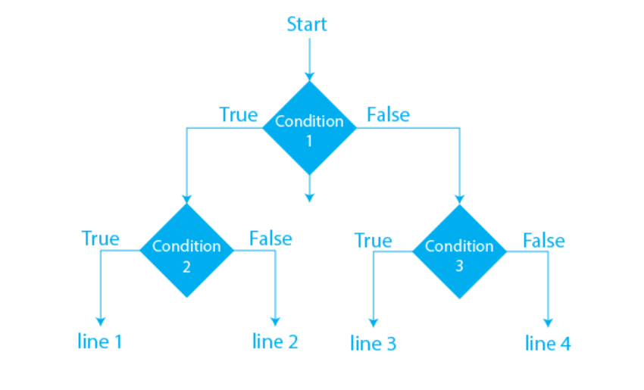
Nested if statement
Syntax
if (condition1){
if (condition2)
line1;
else
line2;
}
else{
if (condition3)
line3;
else
line4;
}

Slide 14
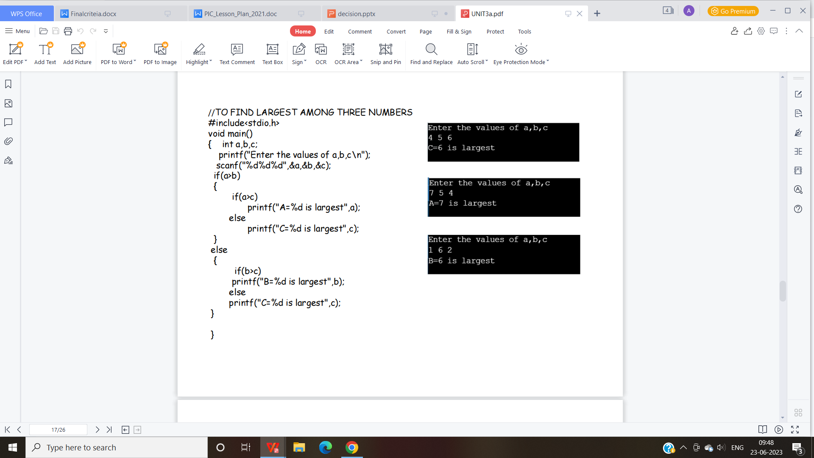
NESTED IF - Example
.

Slide 15
Dangling Else Problem in C
In nested if statements, when a single “else clause” occurs, the situation happens to be dangling else! For example:
if (condition)
if (condition)
if (condition)
else
printf("dangling else!\n"); /* dangling else, as to which if statement, else clause associates */

Slide 16
Solution to Dangling Else Problem in C
1. In such situations, else clause belongs to the closest if statement which is incomplete that is the innermost if statement!
2. However, we can make else clause belong to desired if statement by enclosing all if statements in block outer to which if statement to associate the else clause. For example:
if (condition) {
if (condition)
if (condition)
} else
printf("else associates with the outermost if statement!\n");

Slide 17
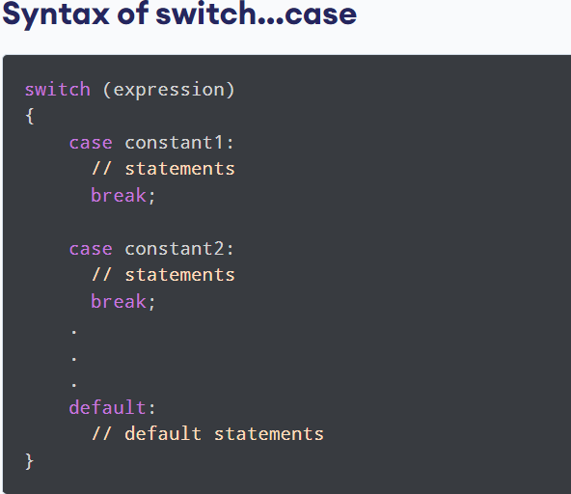
Switch Statement
The switch statement allows us to execute one code block among many alternatives.
You can do the same thing with the if...else..if ladder. However, the syntax of the switch statement is much easier to read and write.
Working
The expression is evaluated once and compared with the values of each case label.
If there is a match, the corresponding statements after the matching label are executed.
For example, if the value of the expression is equal to constant2, statements after case constant2: are executed until break is encountered.
If there is no match, the default statements are executed

Slide 18
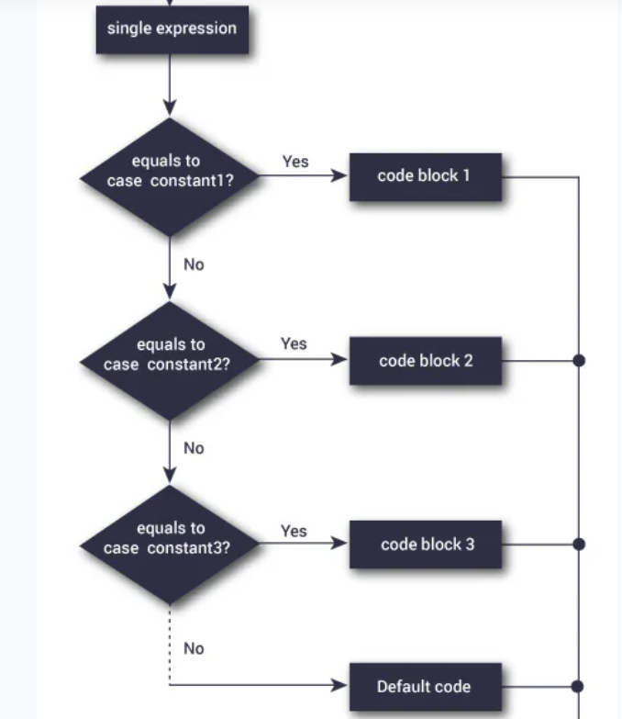

Slide 19
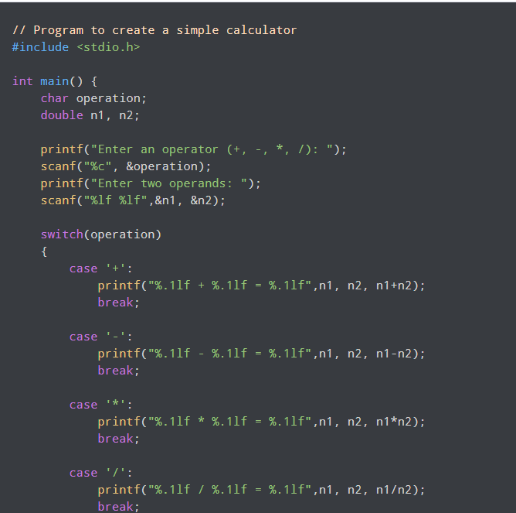
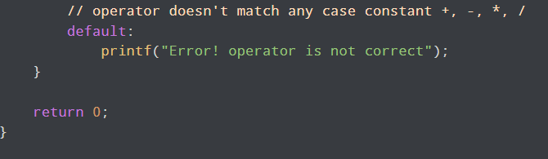
Switch Case – Example

Slide 20
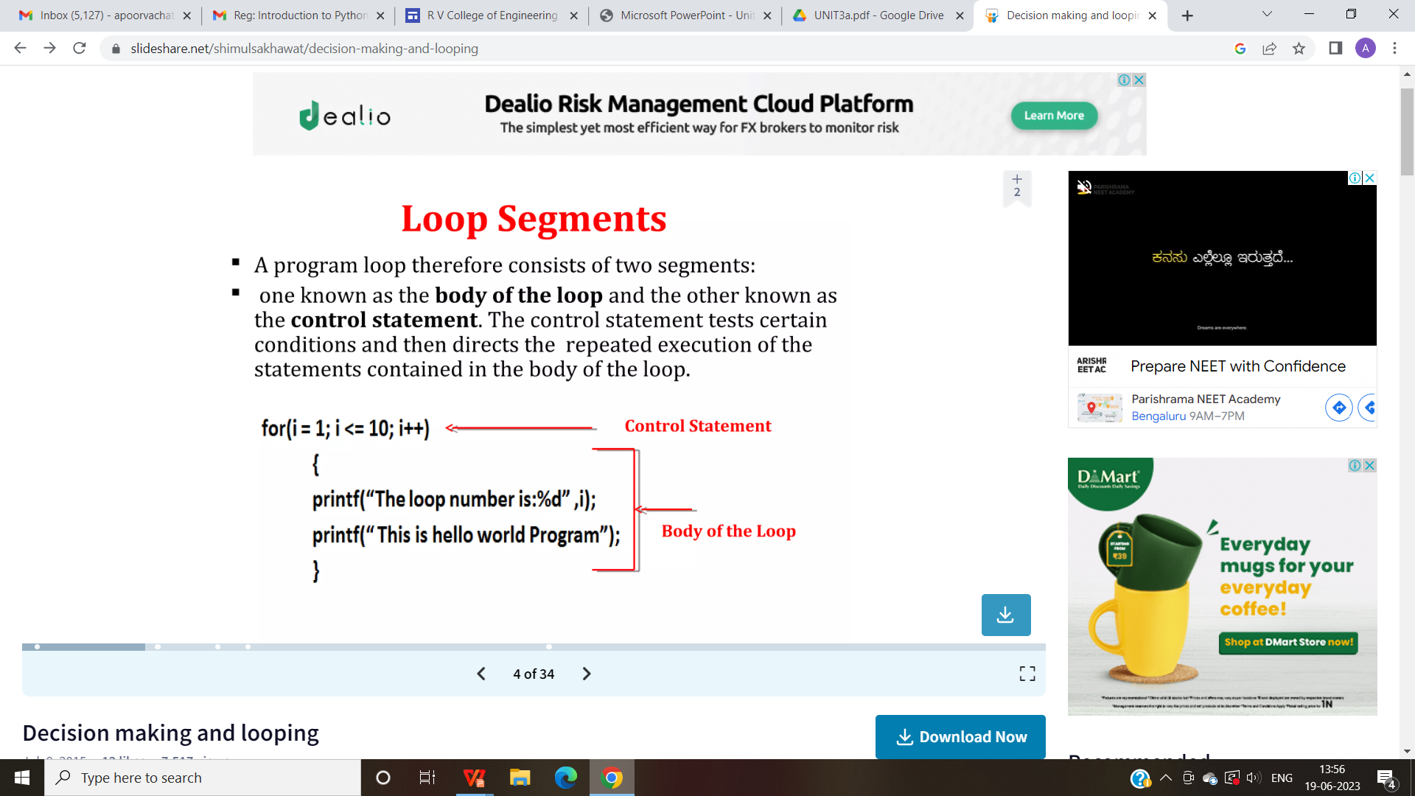
LOOP SEGMENTS
A program loop consists of two segments:
1.Body of the loop.
2. Control statements.
The control statements tests certain conditions and them directs the repeated execution of the statements contained in the body of the loop.

Slide 21
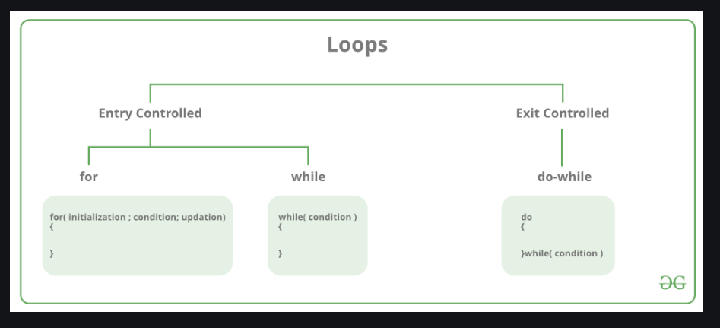
Types of loops
Depending on position of the control statement
There are mainly two types of loops in C Programming:
In an entry control loop in C, a condition is checked before executing the body of a loop. It is also called as a pre-checking loop.
In an exit controlled loop, a condition is checked after executing the body of a loop. It is also called as a post-checking loop.

Slide 22
Types of Loops
Based on the nature of the control variables and the kind of value assigned to the loops may be classified into two general categories.
1.The counter controlled loop.
2.The sentinel controlled loop.

Slide 23
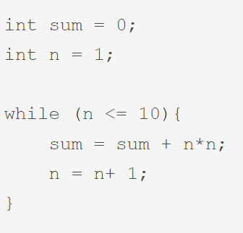
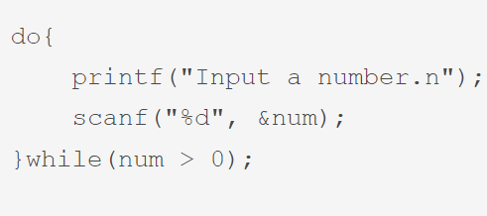
Counter controlled loops are those loops where we know the number of the executions in advance. The control variable is known as counter. In this loop, we set the value of the counter and max limit or condition beforehand.
Sentinel controlled loop are those loop where we do not know the number of execution in advance. In this case, the value of the control variable differs within a limitation and the execution can be terminated at any moment

Slide 24
Types of Loops
C programming has three types of loops:
for loop
while loop
do...while loop

Slide 25
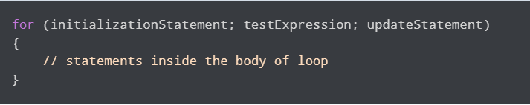
For Loop
The syntax and working of the for loop is:
How for loop works?
The initialization statement is executed only once.
Then, the test expression is evaluated. If the test expression is evaluated to false, the for loop is terminated.
However, if the test expression is evaluated to true, statements inside the body of the for loop are executed, and the update expression is updated.
Again the test expression is evaluated.
This process goes on until the test expression is false. When the test expression is false, the loop terminates.

Slide 26
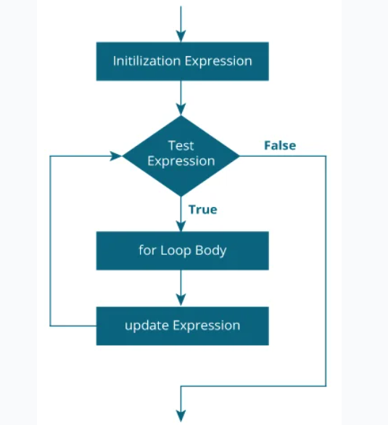
For Loop – Flow Chart

Slide 27
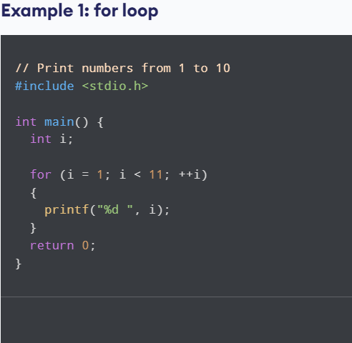
Example – For Loop

Slide 28
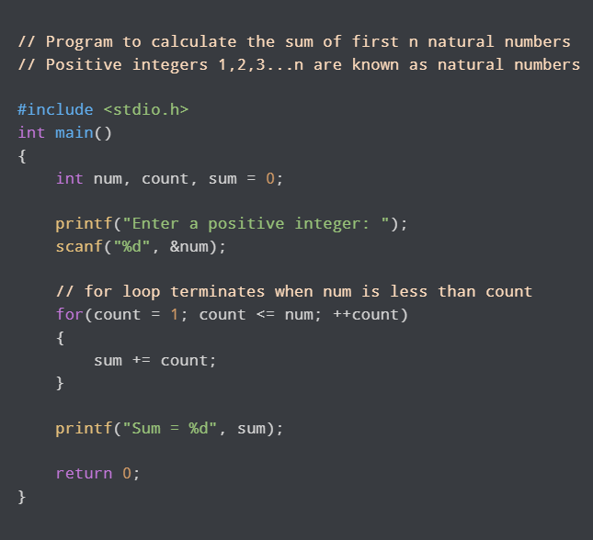
Example -2 Foor Loop

Slide 29
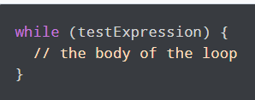
while loop
Syntax and Working of While Loop
The while loop evaluates the test Expression inside the parentheses ().
If test Expression is true, statements inside the body of while loop are executed. Then, test Expression is evaluated again.
The process goes on until test Expression is evaluated to false.
If test Expression is false, the loop terminates (ends).

Slide 30
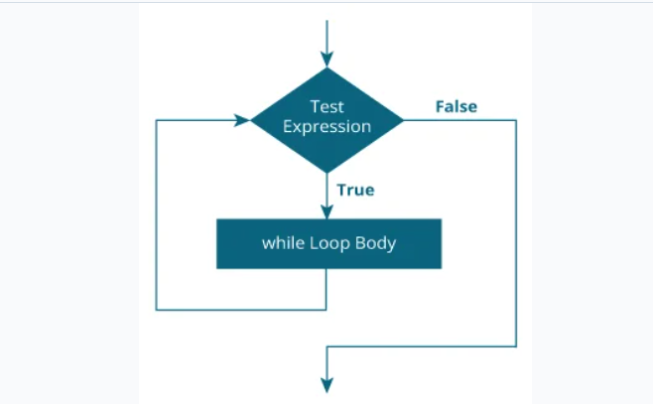
Flow Chart of While Loop

Slide 31
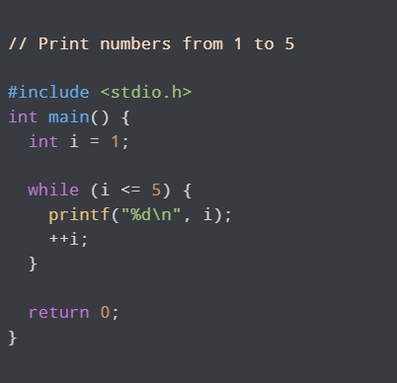
Example -1 –While Loop

Slide 32
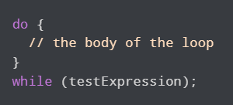
do...while loop
The do..while loop is similar to the while loop with one important difference. The body of do...while loop is executed at least once. Only then, the test expression is evaluated.
The syntax of the do...while loop is:
The body of do...while loop is executed once. Only then, the testExpression is evaluated.
If testExpression is true, the body of the loop is executed again and testExpression is evaluated once more.
This process goes on until testExpression becomes false.
If testExpression is false, the loop ends

Slide 33
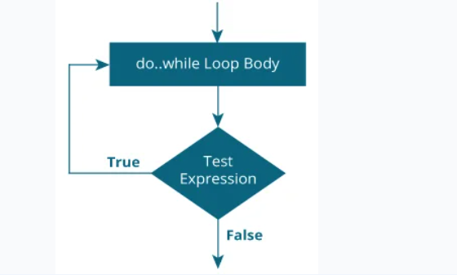
do..while loop –Flow Chart

Slide 34
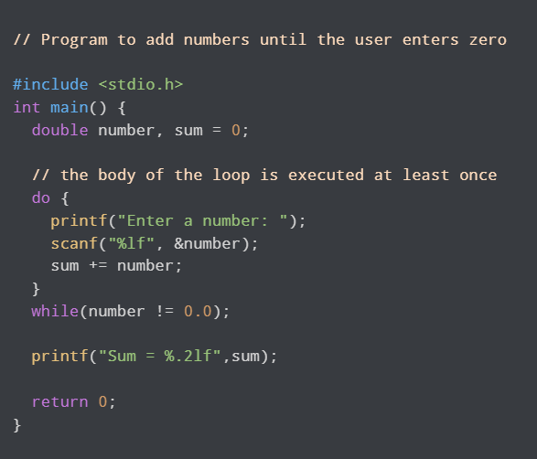
Example – do..while loop

Slide 35
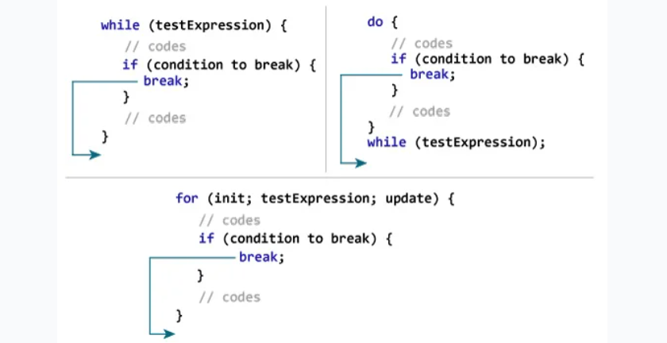
break statement in C
The break statement ends the loop immediately when it is encountered. Its syntax is:
break;

Slide 36
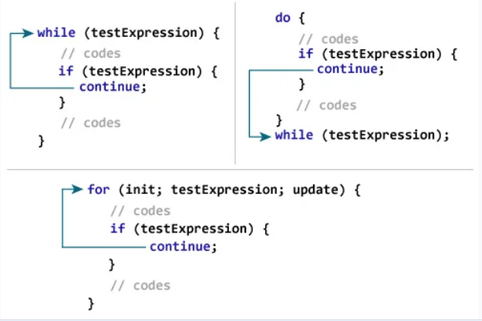
continue statement in c
The continue statement skips the current iteration of the loop and continues with the next iteration.
Its syntax is:
continue;

Slide 37
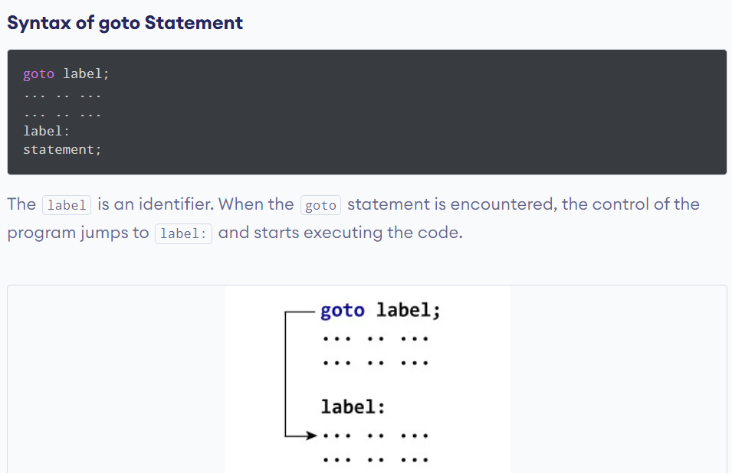
C goto Statement
The goto statement allows us to transfer control of the program to the specified label.

Slide 38
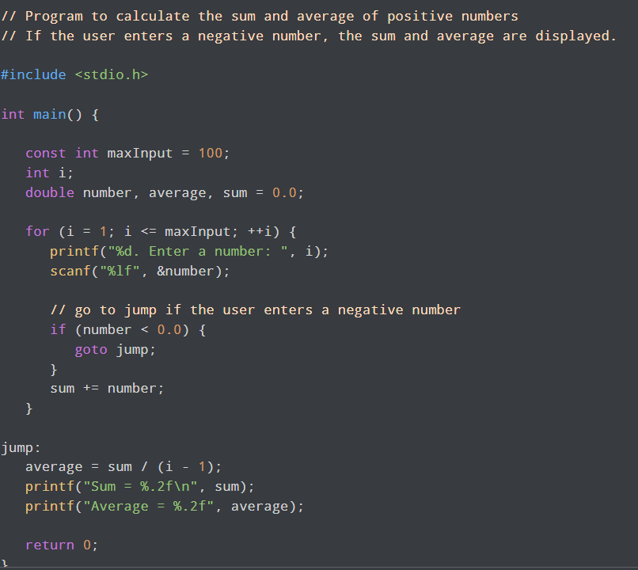
Example – go to statement

